Slide 1

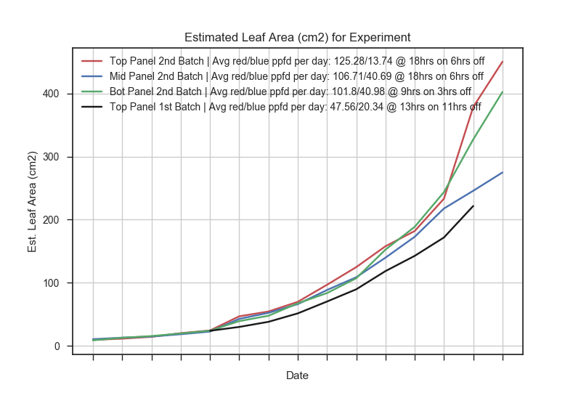
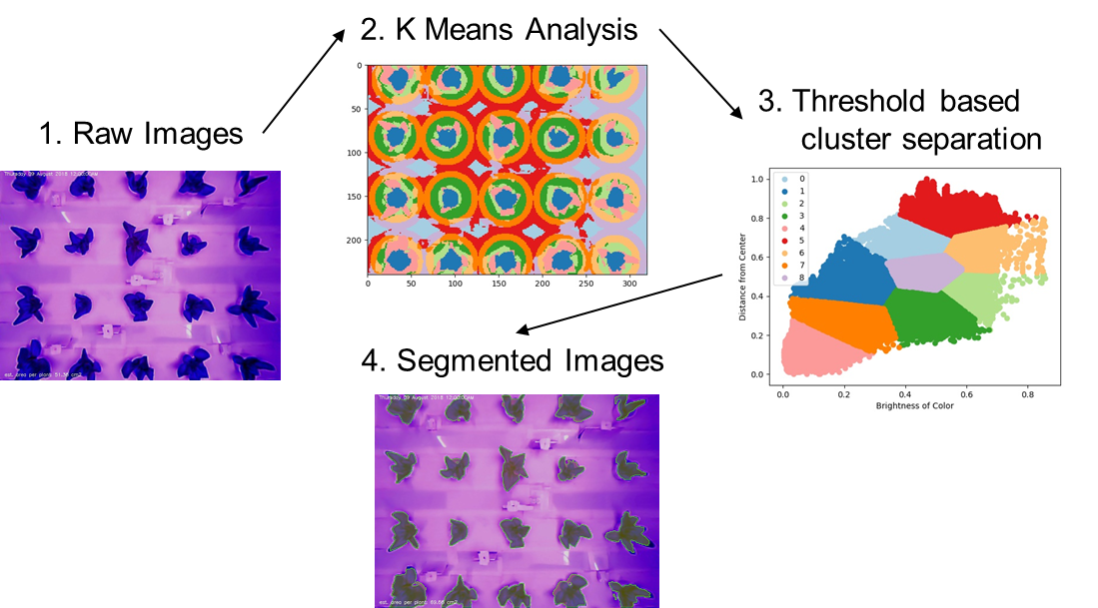
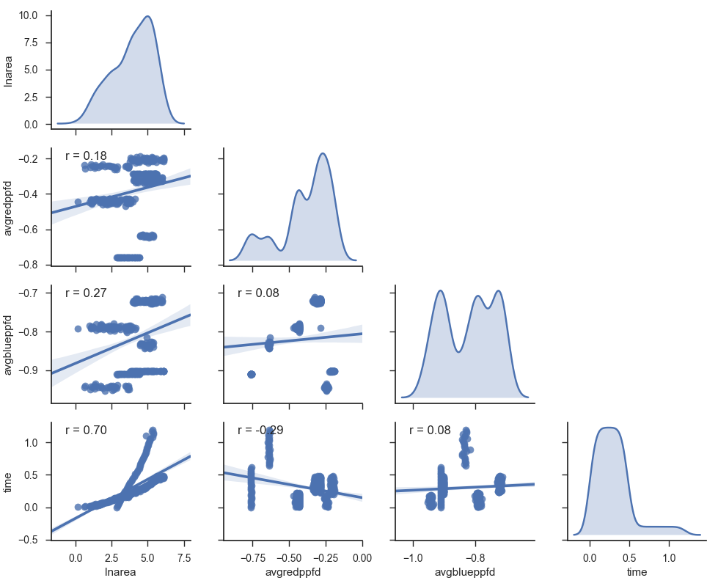
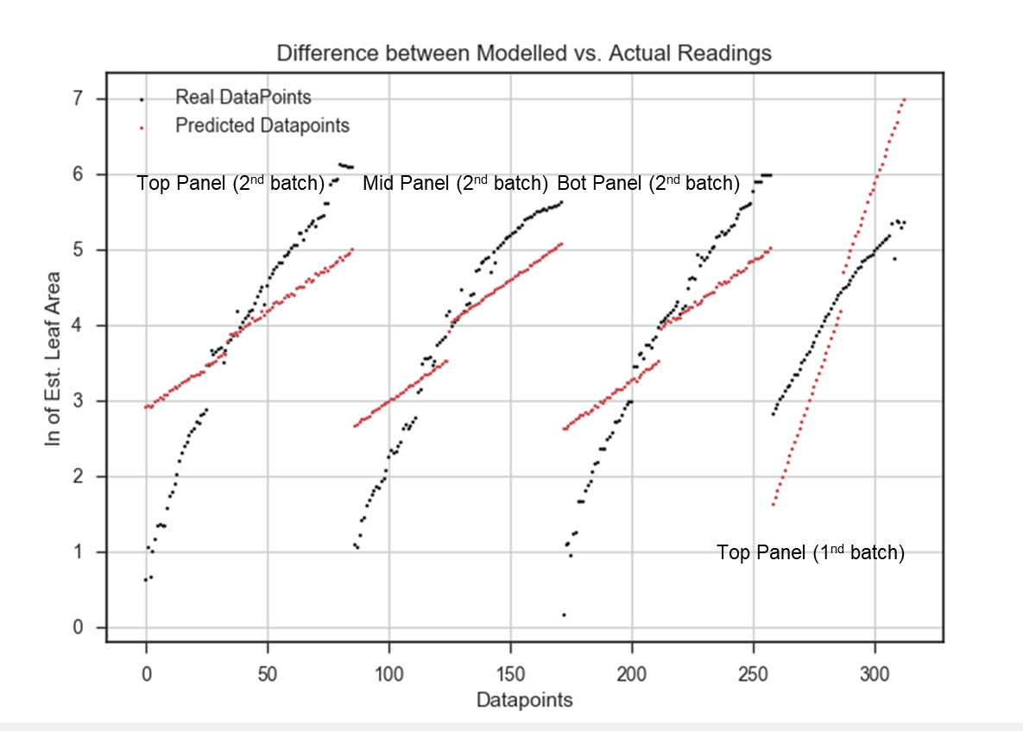
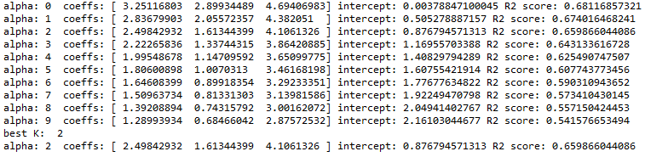
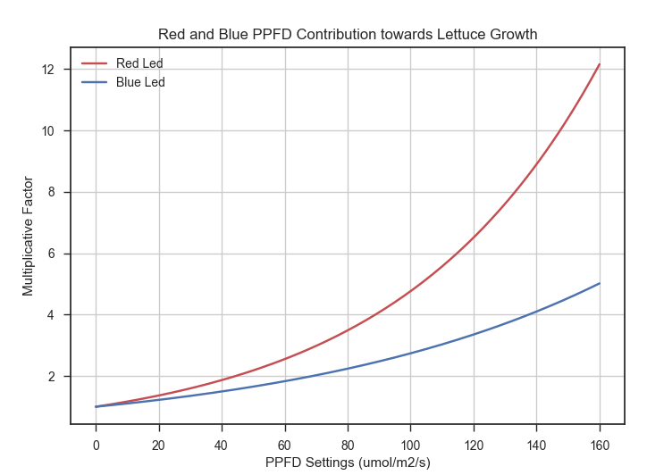

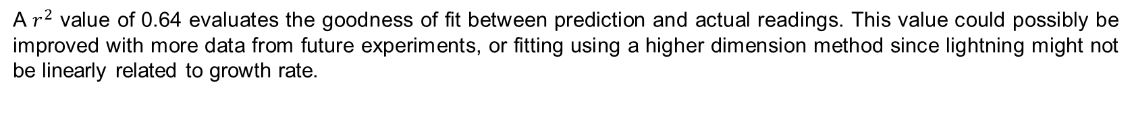
Smart Farm Monitoring System for Horticulture panel Lightning (HPL)
Michael S. Cubillas / Kok Chain Loh (3M Asia Pacific Ptd Ltd)
Lork Jun Hao Clement (Singapore University of Technology and Design)
mscubillas@mmm.com | kcloh@mmm.com | cjlork.cw@mmm.com
Introduction
Data Processing
Leaf Area Estimation
From the pictures collected, we identify the pixels belonging to the plants and used that to estimate the average leaf area of plants in each picture.
Plants exposed to a higher amount of light appeared to grow much better, having a higher area after 14 days.
Analysis and Discussion
HPL Setup
Plant Growth Equation Formulation
Plants growing under non resource constrained situations tend to grow in a exponential pattern according to [I].
Here we extend this model to our experimental setup, considering the 2 controllable factors in our system
Red lighting level and Blue lightning level, for which they are assumed to affect the natural maximum growth rate of the plant linearly. The uncontrolled factors like pH, EC, room temperature, CO2 levels are lumped together as a constant.
Estimated leaf area
Initial leaf area
(set as 7.5cm2 from pictorial data)
Normalized response to Red lighting levels
(averaged PPFD over the day)
(max 160 umol/s/m2)
Normalized response to Blue lighting levels
(averaged PPFD over the day)
(max 160 umol/s/m2)
Natural Growth Rate of Lettuce
Contribution from other non controllable factors
From the equation, we are interested in the finding the constants $a_{i}$, as they illuminate how much each factor impact the leaf area growth.
Exploration of growth factors
The pairplot chart on the left shows the correlation amongst each factor that contributes to the growth rate.
On the diagonals of the charts, we have the distribution of the 4 factors considered. Starting from the top left, leaf area, red level levels, blue light levels, and time.
Computing the correlation between the factors, we can see that time (r=0.70) has the most linear impact on the growth of the leaf area of the plant followed by the amount of blue (r=0.18) and red lighting (r=0.27).
Data Collection
The unexpected low score for lighting might be due to having insufficient variation in lighting levels to explain for the variation in leaf area. For this experiment we only have 3 different lighting levels.
Predictive Modelling using Linear Ridge Regression
The constants $a_{i}$ were estimated using linear regression after transforming the exponential growth equation to a linear one by taking (ln) on both sides. To prevent each factor from being over-represented, we employ a restriction $α$ on the size of the coefficient. The best restriction $α=2$ is chosen by the elbow method.
A $r^{2}$ value of 0.64 evaluates the goodness of fit between prediction and actual readings. This value could possibly be improved with more data from future experiments, or fitting using a higher dimension method since lightning might not be linearly related to growth rate.
Fitted Coefficients : $a_{1}=2.4958 a_{2}=1.613, a_{3}=4.106,a_{4}=0.876$
Conclusion and Growth Optimization
With both leds PPFD at 80 umol/s/m2, the red leds improve the base growth rate by a factor of 3.48, whereas the blue led improve the base growth by only 2.24 times
The multiplicative effect of the red and blue lighting on the natural growth rate can be gathered by factorization from the growth equation.
Due to $a_{1}$> $a_{2}$, the red leds has higher impact on plant growth compared to blue leds.
Currently, the HPL uses 64 red and 64 blue leds from LED manufacturer CREE. As specified by the datasheet, the red led produces 2.36 umol/s of red light per watt of energy compared to 1.82 umol/s of blue light per watt of energy for the blue led.
Since the energy efficiency, as well as the actual photosynthetic effectiveness of blue led is less than that of the red led when cultivating lettuce, it might be more economical to switch all leds in the HPL to red leds when only growing lettuce.
References
Paine, C. T., Marthews, T. R., Vogt, D. R., Purves, D., Rees, M., Hector, A., & Turnbull, L. A. (2012). How to fit nonlinear plant growth models and calculate growth rates: an update for ecologists. Methods in Ecology and Evolution, 3(2), 245-256.
Smart Urban Solutions / 3M Asia Pacific
3M CONFIDENTIAL

Slide 2
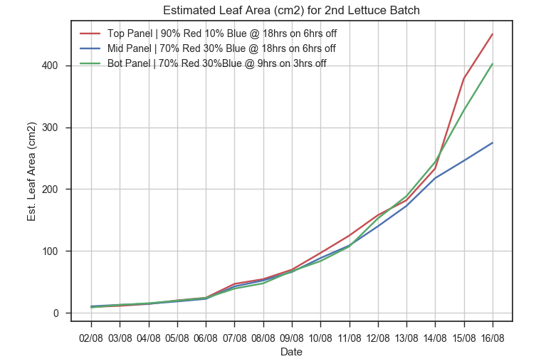
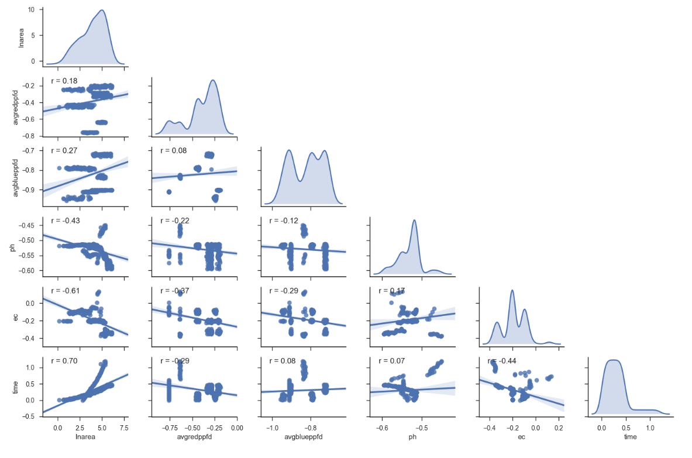
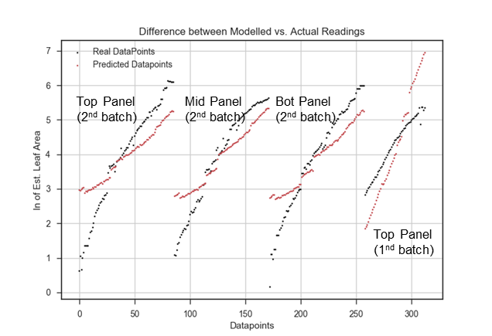
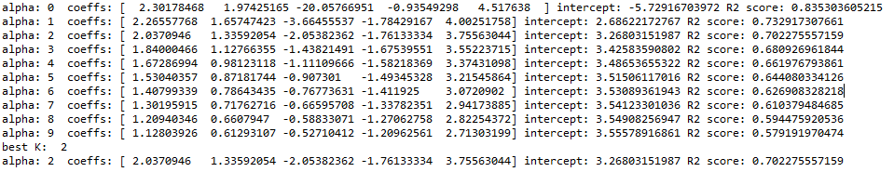
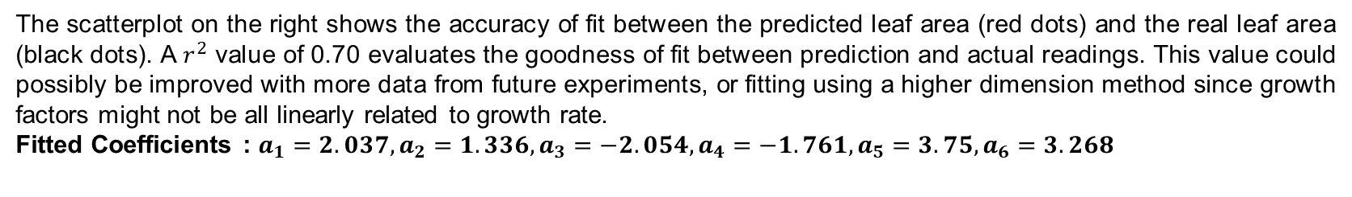
Smart Farm Monitoring System for Horticulture panel Lightning (HPL)
Michael S. Cubillas / Kok Chain Loh (3M Asia Pacific Ptd Ltd)
Lork Jun Hao Clement (Singapore University of Technology and Design)
mscubillas@mmm.com | kcloh@mmm.com | cjlork.cw@mmm.com
Introduction
Data Processing
Leaf Area Estimation
From the pictures collected, we identify the pixels belonging to the plants and used that to estimate the average leaf area of plants in each picture.
Plants exposed to a higher ratio of red light appeared to grow much better, having a higher area after 14 days.
Analysis and Discussion
HPL Setup
Plant Growth Equation Formulation
Plants growing under non resource constrained situations tend to grow in a exponential pattern according to [I].
Here we extend this model to our experimental setup, considering the 4 controllable factors in our system
(Red lighting level, Blue lightning level, pH and EC), for which they are assumed to attenuate the natural maximum growth rate of the plant linearly. The uncontrollable factors like room temperature, CO2 levels are lumped together as a constant as they do not change much during the course of the experiment.
Estimated leaf area
Initial leaf area
(set as 7.5cm2 from pictorial data)
Normalized response to Red lighting levels
(averaged PPFD over the day)
Normalized response to Blue lighting levels
(averaged PPFD over the day)
Normalized response to pH levels
Normalized response to EC levels
Natural Growth Rate of Lettuce
Contribution from other non controllable factors
From the equation, we are interested in the finding the constants $a_{i}$, as they illuminate how much each factor impact the leaf area growth.
Exploration of growth factors
This figure shows the correlation between the each factor that contributes to the growth rate.
The diagonal is the plot of the distribution of each of the factor.
Ranking the factors, we can see that time (r=0.70) has the most linear impact on the growth of the leaf area of the plant followed by the amount of red (r=0.18) and blue lighting (r=0.27). EC (r=-0.61) and pH (r=-0.43) both has negative relationship. This is counter intuitive for EC as
Data Collection
The low score for lighting might be due to having insufficient variation in lighting levels to explain for the variation in leaf area. For this experiment we only have 3 different lighting levels.
Predictive Modelling using Linear Ridge Regression
After transforming the exponential growth equation to a linear one by taking (ln) on both sides, we can estimate the coefficients using linear regression. We employ a restriction $α$ on the size of the coefficient to prevent each factor from being over-represented. The best restriction $α=2$ is chosen by the elbow method.
The scatterplot on the right shows the accuracy of fit between the predicted leaf area (red dots) and the real leaf area (black dots). A $r^{2}$ value of 0.70 evaluates the goodness of fit between prediction and actual readings. This value could possibly be improved with more data from future experiments, or fitting using a higher dimension method since growth factors might not be all linearly related to growth rate.
Fitted Coefficients : $a_{1}=2.037, a_{2}=1.336, a_{3}=−2.054,a_{4}=−1.761,a_{5}=3.75, a_{6}=3.268$
Conclusion and Growth Optimization
This point, EC should have a positive coefficient. Perhaps we did not perturb EC enough to show grow rate with EC
References
Paine, C. T., Marthews, T. R., Vogt, D. R., Purves, D., Rees, M., Hector, A., & Turnbull, L. A. (2012). How to fit nonlinear plant growth models and calculate growth rates: an update for ecologists. Methods in Ecology and Evolution, 3(2), 245-256.
Chen, T. W., Chen, Y. L., & Chien, S. Y. (2008, October). Fast image segmentation based on K-Means clustering with histograms in HSV color space. In multimedia signal processing, 2008 IEEE 10th Workshop on (pp. 322-325). IEEE.
Smart Urban Solutions / 3M Asia Pacific
3M CONFIDENTIAL

Slide 3

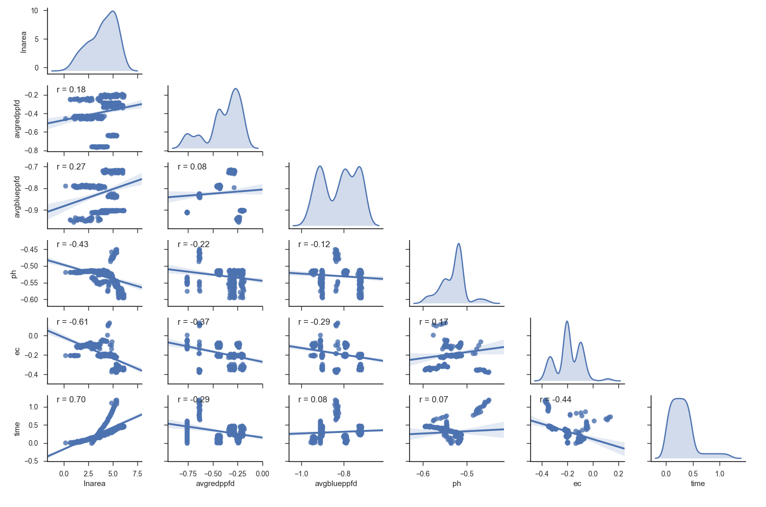

Smart Farm Monitoring System for Horticulture panel Lightning (HPL)
Michael S. Cubillas / Kok Chain Loh (3M Asia Pacific Ptd Ltd)
Lork Jun Hao Clement (Singapore University of Technology and Design)
Introduction
Data Processing
Leaf Area Estimation
From the pictures collected, we identify the pixels belonging to the plants and used that to estimate the average leaf area of plants in each picture.
Plants exposed to a higher ratio of red light appeared to grow much better, having a higher area after 14 days.
HPL Setup
Analysis and Discussion
Plant Model Building
Plants growing under non resource constrained situations tend to grow in a exponential pattern according to [I].
Here we extend this model to our experimental setup, considering the 4 controllable factors in our system
(Red lighting level, Blue lightning level, pH and EC), for which they are assumed to attenuate the natural maximum growth rate of the plant. The uncontrollable factors like room temperature, co2 levels are lumped together as a constant as they do not change much during the course of the experiment.
Estimated leaf area
Initial leaf area
(set as 7.5cm2 from pictorial data)
Normalized response to Red lighting levels
(averaged PPFD over the day)
Normalized response to Blue lighting levels
(averaged PPFD over the day)
Normalized response to pH levels
Normalized response to EC levels
Natural Growth Rate of Lettuce
Contribution from other non controllable factors
We are interested in the
Pairplot of growth factors
This figure shows the correlation between the each factor that contributes to the growth rate.
The diagonal is the plot of the distribution of each of the factor.
Data Collection
Ranking the factors, we can see that time (r=0.70) has the most linear impact on the growth of the leaf area of the plant, followed by EC (r=-0.61) and pH (r=-0.43), before the amount of red (r=0.18) and blue lighting (r=0.27).
Solved for coefficients using Linear Ridge Regression with alpha factor being 2. Explain why use ridge regression
Explain significance of results.
In terms of optimizing electrical power
Least amount of fertilizer
References
Paine, C. T., Marthews, T. R., Vogt, D. R., Purves, D., Rees, M., Hector, A., & Turnbull, L. A. (2012). How to fit nonlinear plant growth models and calculate growth rates: an update for ecologists. Methods in Ecology and Evolution, 3(2), 245-256.
Chen, T. W., Chen, Y. L., & Chien, S. Y. (2008, October). Fast image segmentation based on K-Means clustering with histograms in HSV color space. In multimedia signal processing, 2008 IEEE 10th Workshop on (pp. 322-325). IEEE.
Smart Urban Solutions / 3M Asia Pacific
3M CONFIDENTIAL

Slide 4
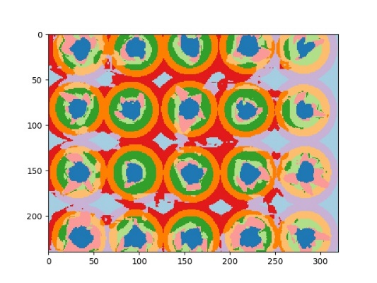
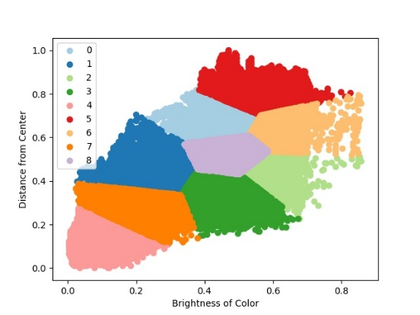
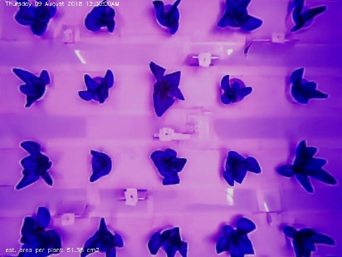
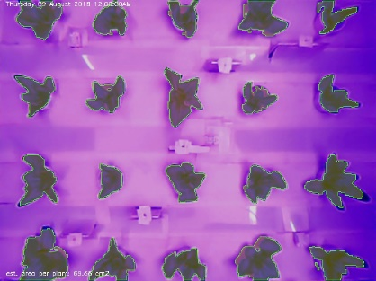
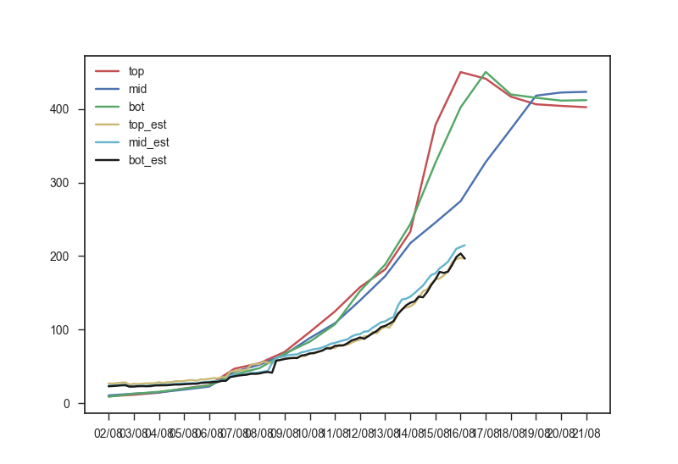
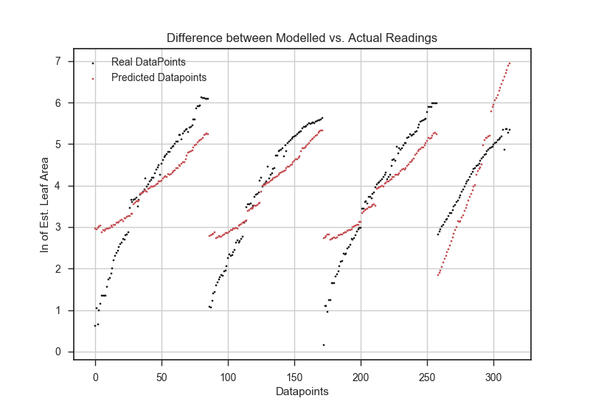
1. Raw Images
2. K Means Analysis
3. Threshold based
cluster separation
4. Segmented Images
Top Panel (2nd batch)
Mid Panel (2nd batch)
Bot Panel (2nd batch)
Top Panel (1nd batch)

